Slide 1
COMP2009
Software Engineering and Human–Computer Interaction (HCI)
Introduction to HCI
Ann Blandford
Oct - Dec 2009

Slide 2
Aims of the HCI course
By the end of the course, you should…
  Be aware of the importance of users and usage in design: making technology fit for purpose
  Be familiar with a representative set of user-centred design and evaluation methods
  Be able to apply selected methods to develop user-centred systems with confidence and competence

Slide 3
Course structure
Introduction
Planning studies
Gathering user data
Analysing user data
Design principles and guidelines
Design patterns (Simon Attfield)
Personas and scenarios
Designing interactions
Analytical evaluation
Empirical evaluation

Slide 4
Practical matters
Lecture notes, papers and links will be made available via Moodle
  Enrolment key: HCI-AB
Core text:
  Sharp, Rogers & Preece (2007)
  Interaction Design (2nd Edition) Wiley.
Assessment:
  Coursework (3.33%), Exam question

Slide 5
Aims of this lecture
To consider why users matter in design
To start developing critical thinking skills – particularly regarding usability
To consider role of users in design practice

Slide 6
NB: what do I mean by “usability”?
In this course, the word “usability” is used in a very wide sense, to cover:
  “Classic” usability: efficiency, effectiveness, satisfaction
  User experience
  Broader fit of system in its context of use
… remembering that “users” are people who make use of a whole ecology of tools to support their activities and interactions

Slide 7
Informal evaluation
(sometimes called “Expert Review”)
Think of a system that you consider to be poorly designed. What is it about the system that you consider to be poor?
Think of a system that you consider to be well designed. What is it about the system that you consider good?

Slide 8
Some interaction disasters

Slide 9
Not quite a disaster, but …?!?

Slide 10
Motivations for interaction
“Hygiene” goals:
  System:
    Reliability
    Timeliness
    Efficiency
    Effectiveness
  Human:
    Safety
    Avoiding social embarrassment
    Avoiding “breaking things”
  …etc.
Experience goals:
  Delight
  Understanding
    Planning
    Sensemaking
  Engagement / immersion
  Engagement with other people
  …etc.

Slide 11
How do we know?
Invoke theory and learn from history
Ask people about perceptions and values
Observe people and understand their practices
Prototype and test with intended users
  In controlled settings
  In “the wild”

Slide 12
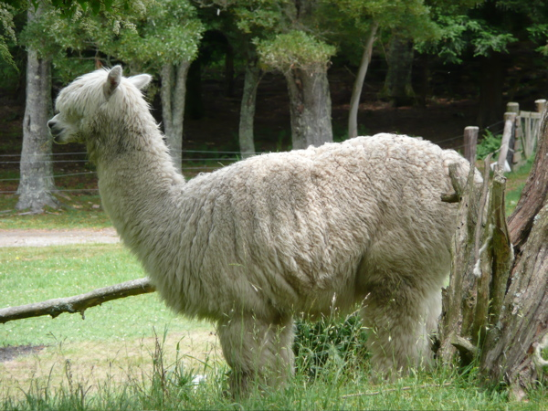
A view of design
Two major forces for design:
  Needs
    Existing technologies don’t work as required
  Opportunities
    New technologies that fill a need that might not even have been recognised as such
Two situations for taking the user perspective:
  Understanding needs and practices
  Evaluating designs (prototypes or full implementations)

Slide 13
One view of development processes:
Star lifecycle (Hartson & Hix)
Evaluation between every phase:
  Task / functional analysis
  Requirements / specification
  Conceptual design / formal design representation
  Prototyping
  Implementation

Slide 14
A second view of development processes:
Sharp, Rogers & Preece
Identify needs / establish requirements
(Re)design
Build an interactive version
Evaluate
Iterate, iterate, iterate

Slide 15
User focus
“If the user can’t use it then it doesn’t work”
      Susan Dray
“HCI is the conscience of Computer Science”
      Alan Dix

Slide 16
Summary
You will study design lifecycles and processes more in the SE part of this course.
In the HCI part, we cover three phases:
  Requirements gathering
  Design
  Evaluation
We do not focus on particular design representations, but on understanding people and their needs.

Slide 17
Questions?

